Slide 1
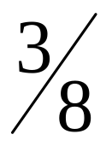
Chapter 07.08: Simpson Rule For Integration.

Slide 2
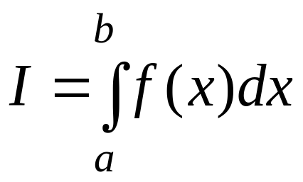
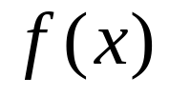


Introduction
The main objective in this chapter is to develop appropriated formulas for obtaining the integral expressed in the following form:
(1)
where is a given function.
Most (if not all) of the developed formulas for integration
is based on a simple concept of replacing a given
(oftently complicated) function by a simpler
function (usually a polynomial function) where
represents the order of the polynomial function.

Slide 3

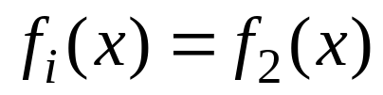
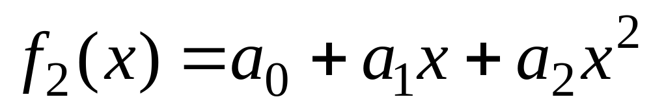
In the previous chapter, it has been explained and
illustrated that Simpsons 1/3 rule for integration can
be derived by replacing the given function
with the 2nd –order (or quadratic) polynomial function
, defined as:
(2)

Slide 4
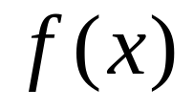

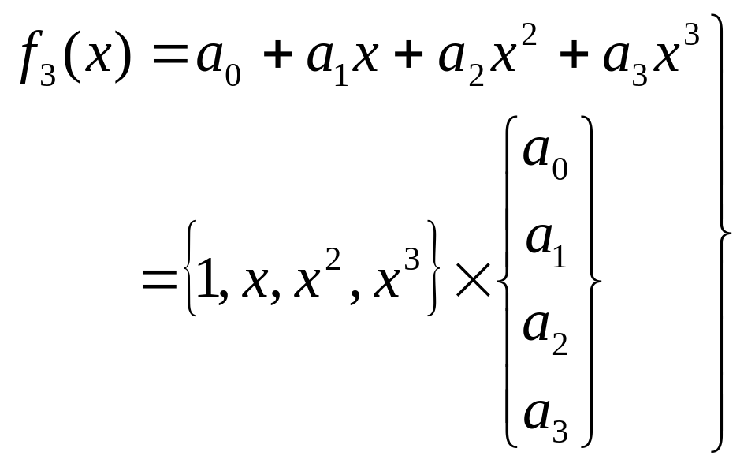
In a similar fashion, Simpson rule for integration
can be derived by replacing the given function
with the 3rd-order (or cubic) polynomial (passing
through 4 known data points) function
defined as
(3)
which can also be symbolically represented in Figure 1.

Slide 5
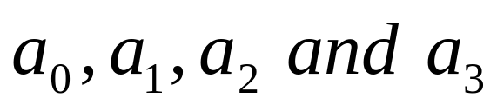
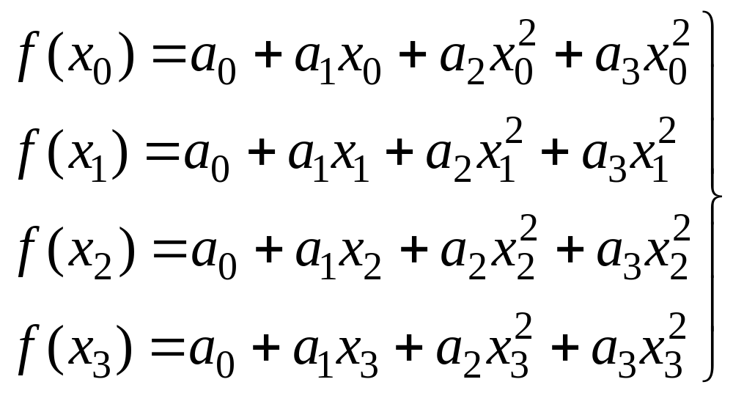
Method 1
The unknown coefficients (in Eq. (3))
can be obtained by substituting 4 known coordinate
data points
into Eq. (3), as following
(4)

Slide 6
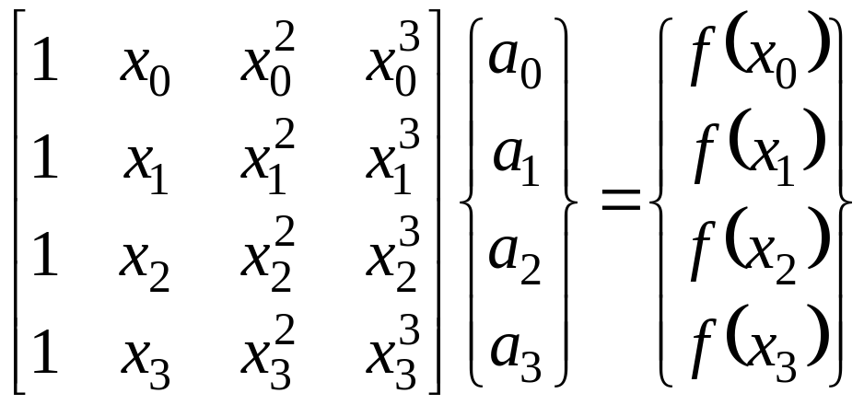
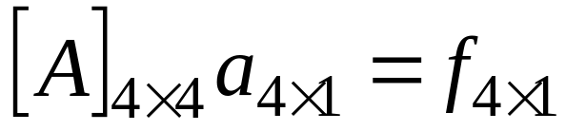
Eq. (4) can be expressed in matrix notation as
(5)
The above Eq. (5) can be symbolically represented as
(6)

Slide 7
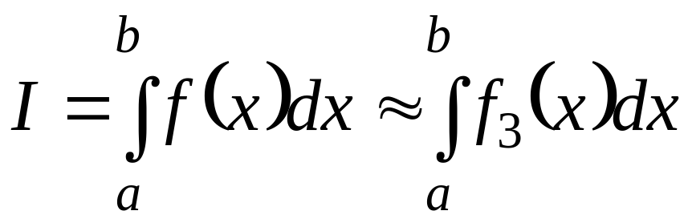
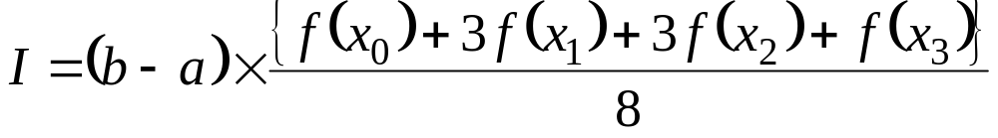
Simpsons Rule For
Integration
Thus, Eq. (1) can be calculated as (See Eqs. 8, 10 for
Method 1 and Method 2, respectively):
Integrating the right-hand-side of the above equations, one obtains
(11)

Slide 8
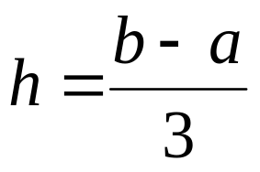

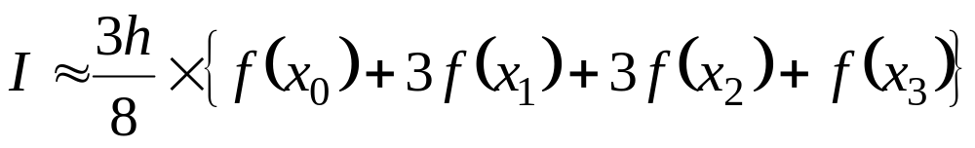
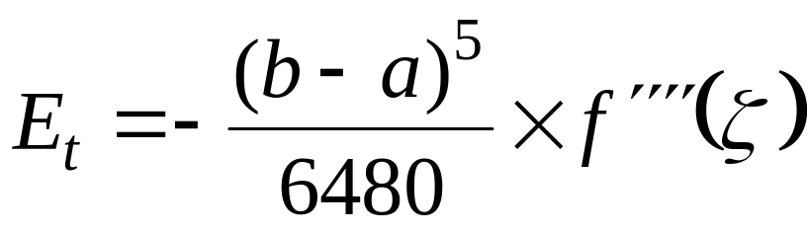
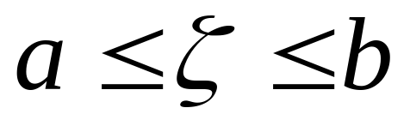
Since hence , and the above
equation becomes:
(12)
The error introduced by the Simpson 3/8 rule can be
derived as [Ref. 1]:
, where
(13)

Slide 9
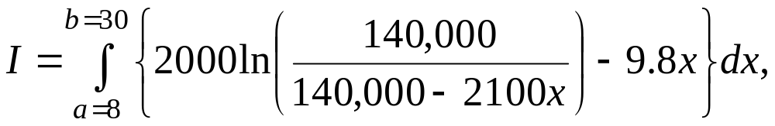
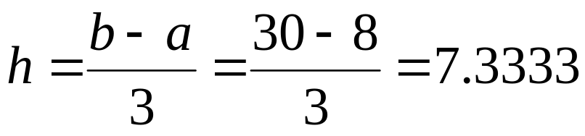
Example 1 (Single Simpson rule)
Compute
by using a single segment Simpson rule
Solution
In this example:

Slide 10
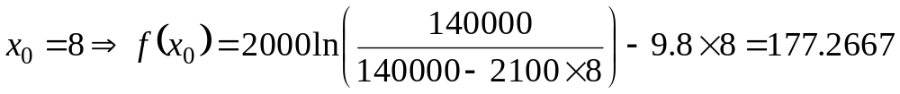
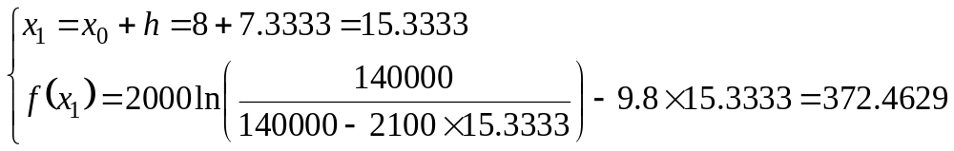

Slide 11
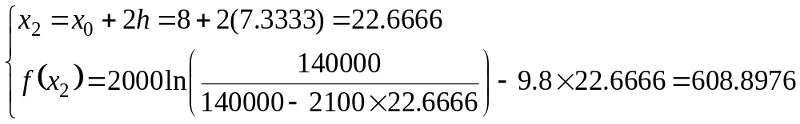
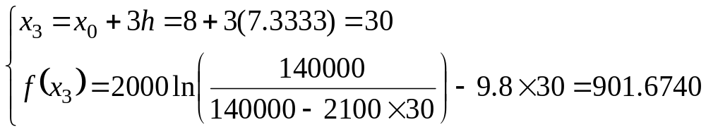

Slide 12
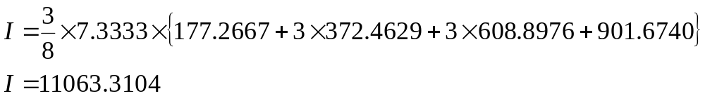
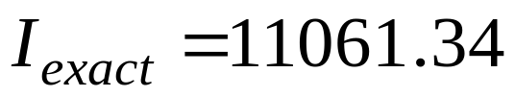
Applying Eq. (12), one has:
The “exact” answer can be computed as

Slide 13




3. Multiple Segments for
Simpson Rule
Using = number of equal (small) segments, the
width can be defined as
(14)
Notes:
= multiple of 3 = number of small segments

Slide 14

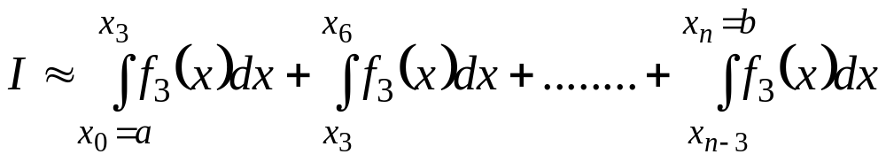
The integral, shown in Eq. (1), can be expressed as
(15)

Slide 15
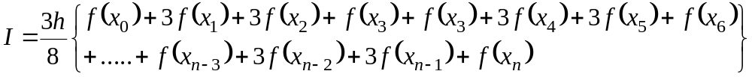
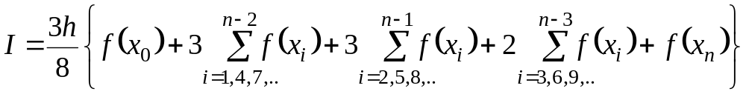
Substituting Simpson rule (See Eq. 12) into
Eq. (15), one gets
(16)
(17)

Slide 16
Example 2 (Multiple segments Simpson rule)
Compute
using Simple multiple segments rule, with number
(of ) segments = = 6 (which corresponds to 2
“big” segments).

Slide 17
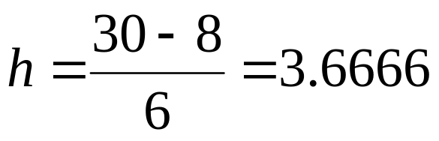

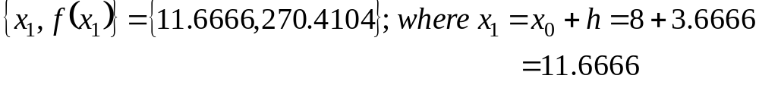
Solution
In this example, one has (see Eq. 14):

Slide 19
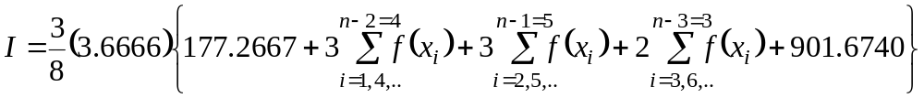

Applying Eq. (17), one obtains:

Slide 20
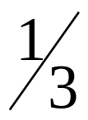
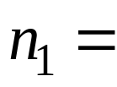
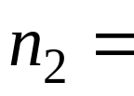
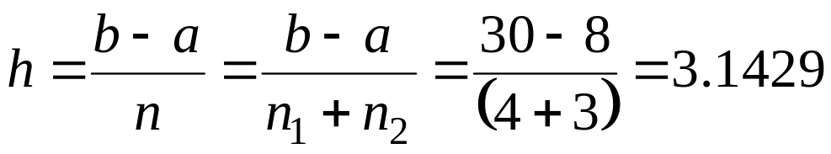
Example 3 (Mixed, multiple segments Simpson and
rules)
Compute
using Simpson 1/3 rule (with 4 small segments), and
Simpson 3/8 rule (with 3 small segments).
Solution:
In this example, one has:

Slide 21
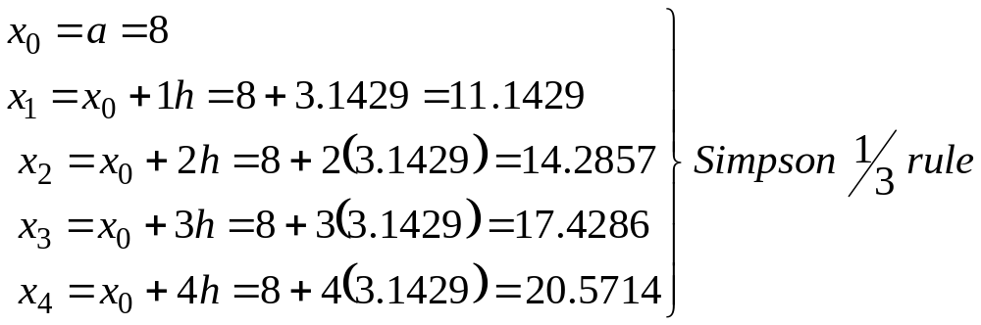
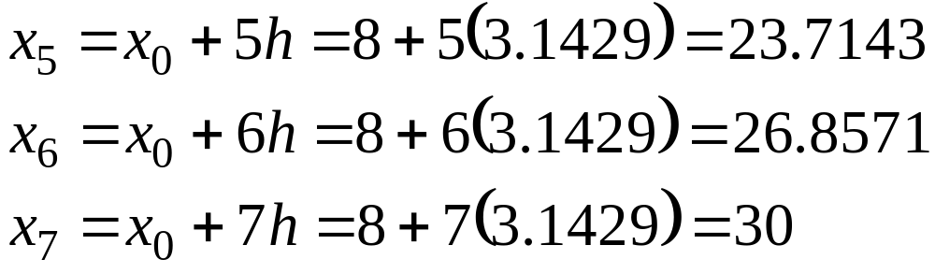

Slide 22
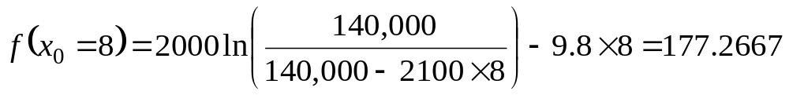
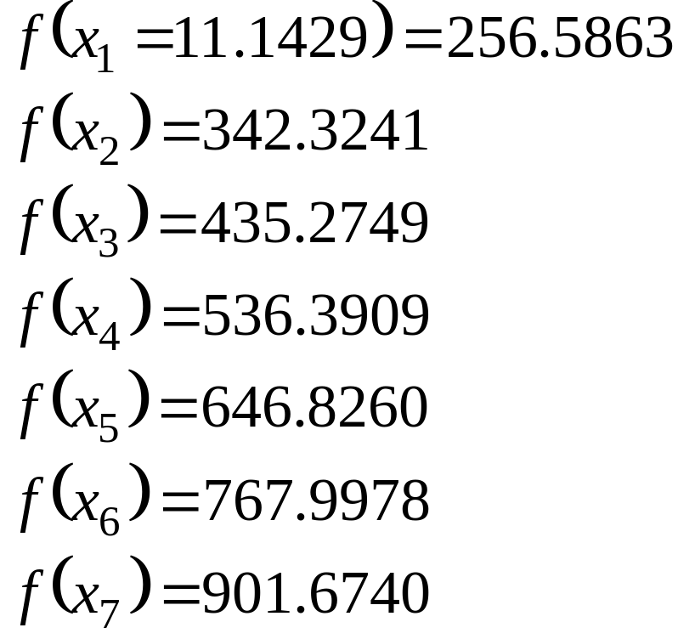
Similarly:

Slide 23
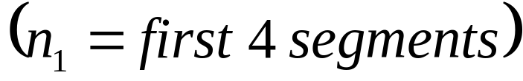

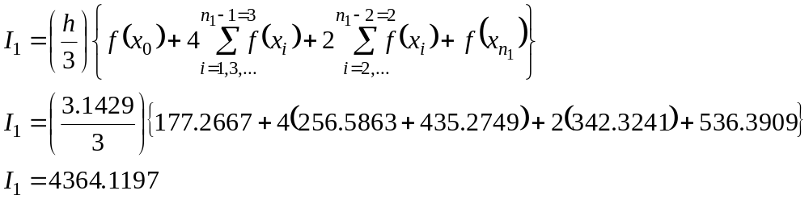
For multiple segments
using Simpson rule, one obtains (See Eq. 19):

Slide 24
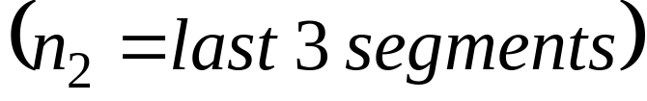
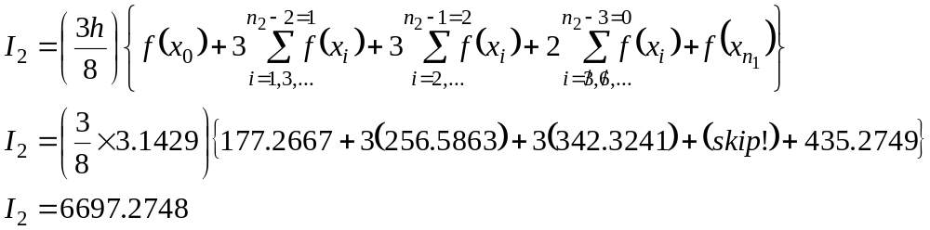
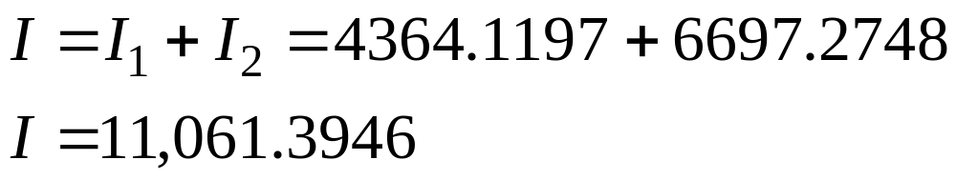
For multiple segments
using Simpson 3/8 rule, one obtains (See Eq. 17):
The mixed (combined) Simpson 1/3 and 3/8 rules give:

Slide 25
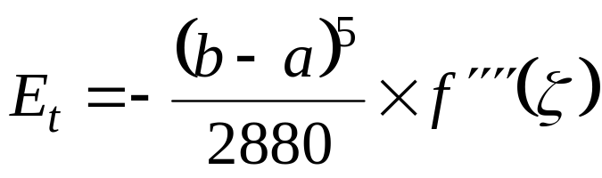
Remarks:
(a) Comparing the truncated error of Simpson 1/3 rule
(18)
With Simple 3/8 rule (See Eq. 13), the latter seems to
offer slightly more accurate answer than the former.
However, the cost associated with Simpson 3/8 rule
(using 3rd order polynomial function) is significant
higher than the one associated with Simpson 1/3 rule
(using 2nd order polynomial function).

Slide 26
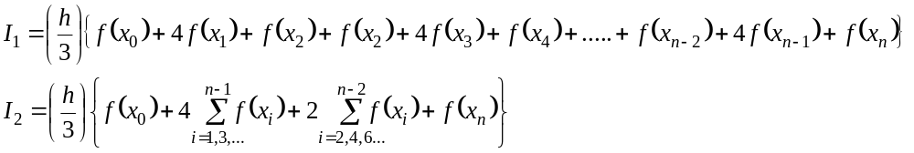
(b) The number of multiple segments that can be used
in the conjunction with Simpson 1/3 rule is 2,4,6,8,..
(any even numbers).
(19)

Slide 27
However, Simpson 3/8 rule can be used with the
number of segments equal to 3,6,9,12,.. (can be
either certain odd or even numbers).
(c) If the user wishes to use, say 7 segments, then the
mixed Simpson 1/3 rule (for the first 4 segments),
and Simpson 3/8 rule (for the last 3 segments).

Slide 28
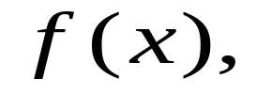

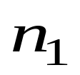
4. Computer Algorithm For Mixed Simpson
1/3 and 3/8
rule For Integration
Based on the earlier discussions on (Single and Multiple
segments) Simpson 1/3 and 3/8 rules, the following
“pseudo” step-by-step mixed Simpson rules can be given
as
Step 1 User’s input information, such as
Given function integral limits
= number of small, “h” segments, in conjunction with
Simpson 1/3 rule.

Slide 29
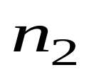


= number of small, “h” segments, in conjunction with
Simpson 3/8 rule.
Notes:
= a multiple of 2 (any even numbers)
= a multiple of 3 (can be certain odd, or even
numbers)

Slide 30
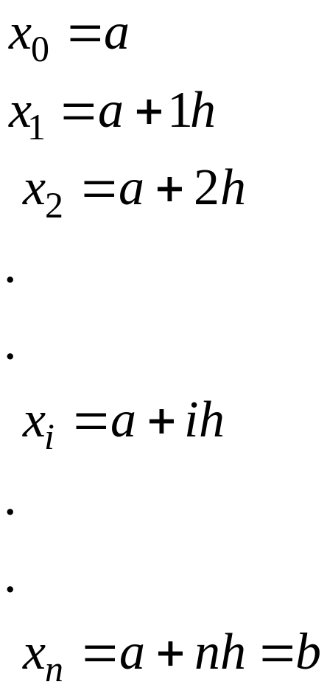


Step 2
Compute

Slide 31

Step 3
Compute “multiple segments” Simpson 1/3 rule (See
Eq. 19)
(19, repeated)

Slide 32


Step 4
Compute “multiple segments” Simpson 3/8 rule (See
Eq. 17)
(17, repeated)
Step 5
(20)
and print out the final approximated answer for I.

